Slide 1
Instruction Manual Slides InSpect and AutoSpect GUI
Dr. Andrew M. Crawford
2024 - 10 - 28

Slide 2
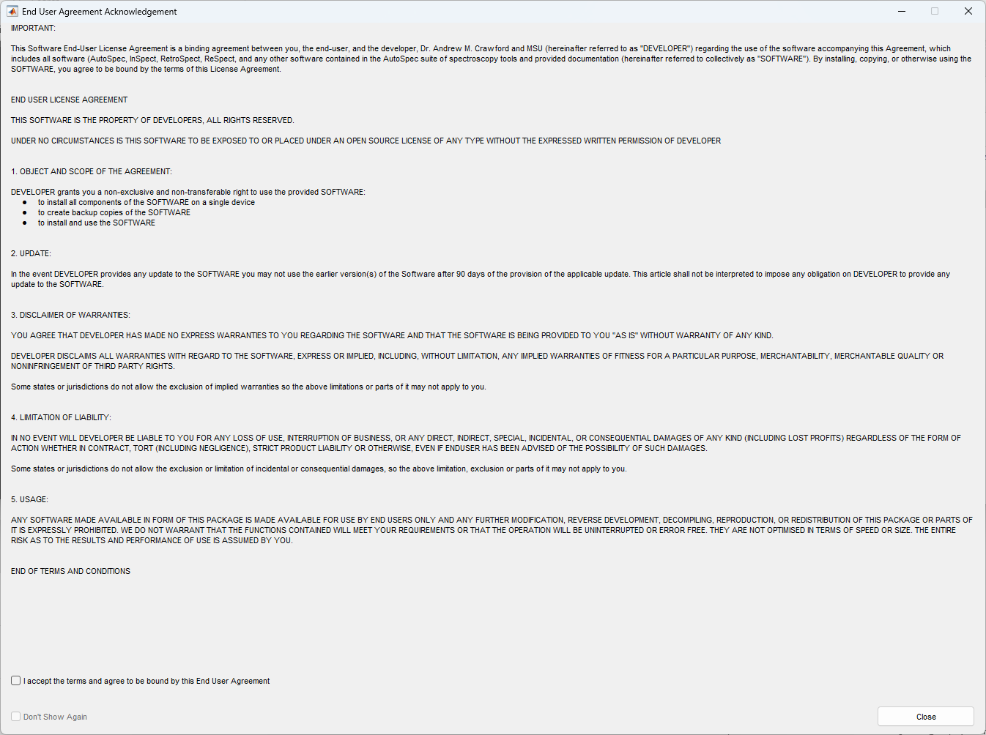
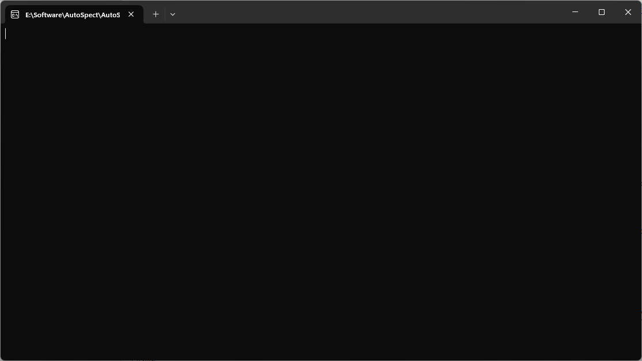
a
a
a
a
b
a
c
a
d
a
e
f
a
g
a
h
a
i
a
j
a
k
l
a
m
a
n
o
p
q
r
s
t

Slide 3
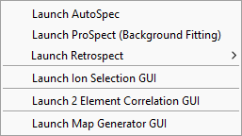


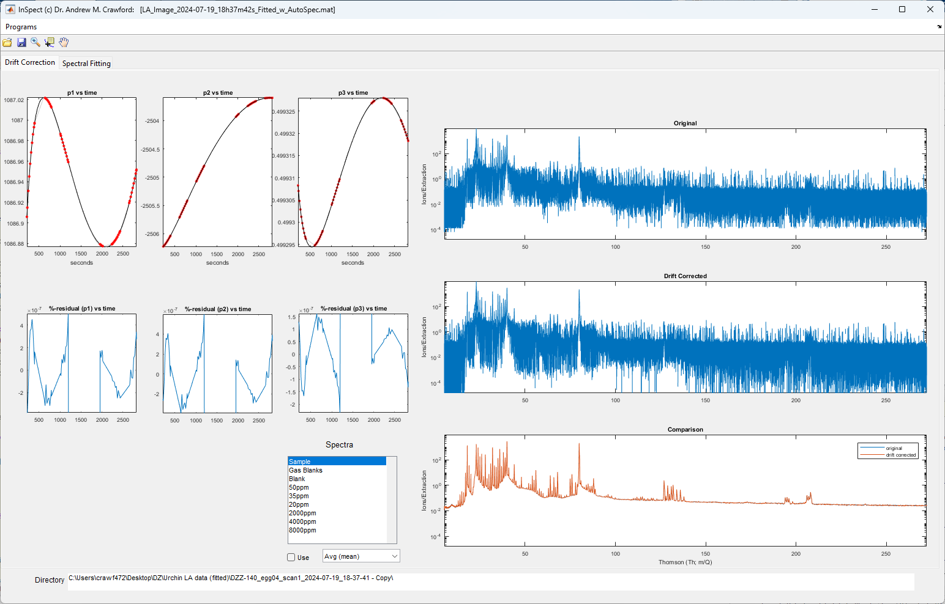
Menu
Context Menus
a
5
c
*
6
a
b
e
b
c
f
d
g
a
b
c
d
e
f
b
c
d
a
b
c
e
f
3
g
h
i
a
j
*
k
2
l
m
n
d
e
f
o
p
b
q
r
s
t
1
*
a
4
c
b
c
a

Slide 4
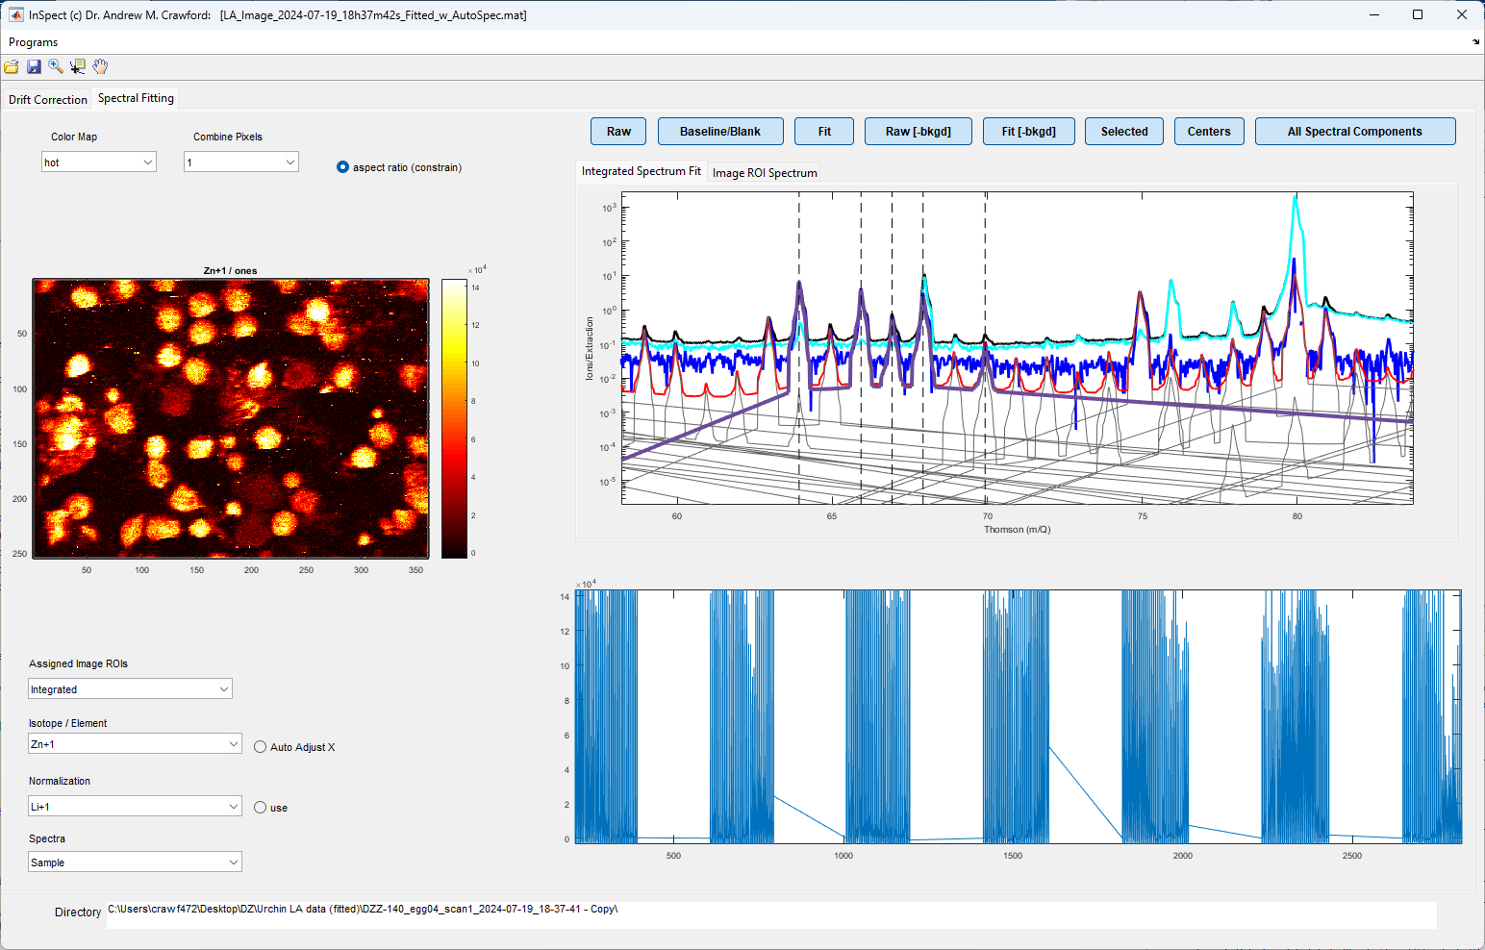

a
b
c
d
e
f
b
e
f
g
h
i
j
k
l
c
d
a
b
c
a
b
c
e
*_{2c}
f
g
*
h
d
*₁
i
j
k
l
2
m
n
o
p
d
q
r
e
1
*
*_{2d}
s
t
f
g
i
h
j
a
Context Menus
*_{1, 2d}
*_{2c}
*
a
c
e
b
d

Slide 5
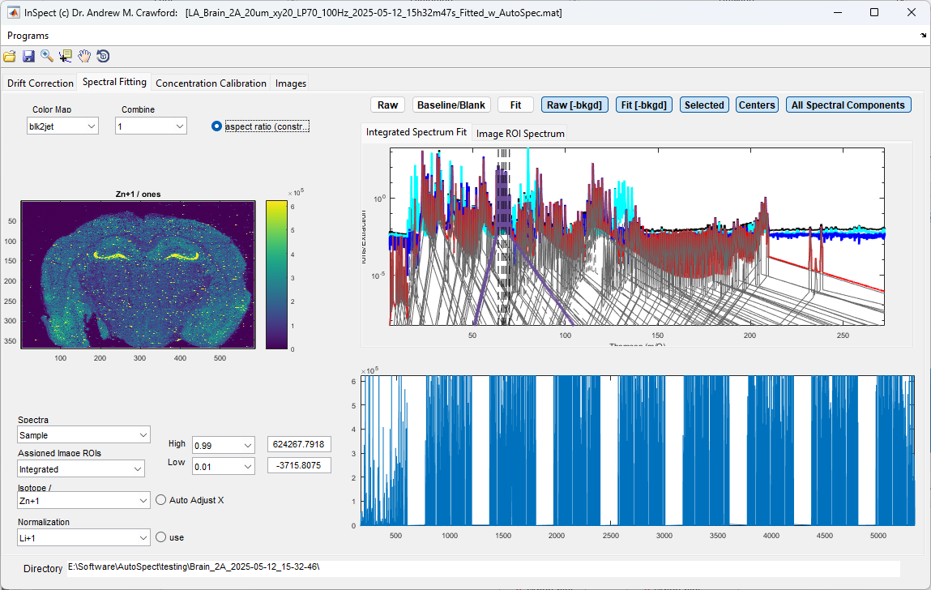
a
b
c
d
e
f
g
b
e
f
g
h
i
j
k
l
c
c
d
a
b
a
b
c
e
*_{2c}
f
g
*
h
d
*₁
i
j
k
l
2
m
n
o
1
p
*
d
q
r
e
m
*_{2d}
s
k
t
f
l
n
g
i
h
j
a
3
Context Menus
*_{1, 2d}
*_{2c}
*
a
c
e
b
d

Slide 6
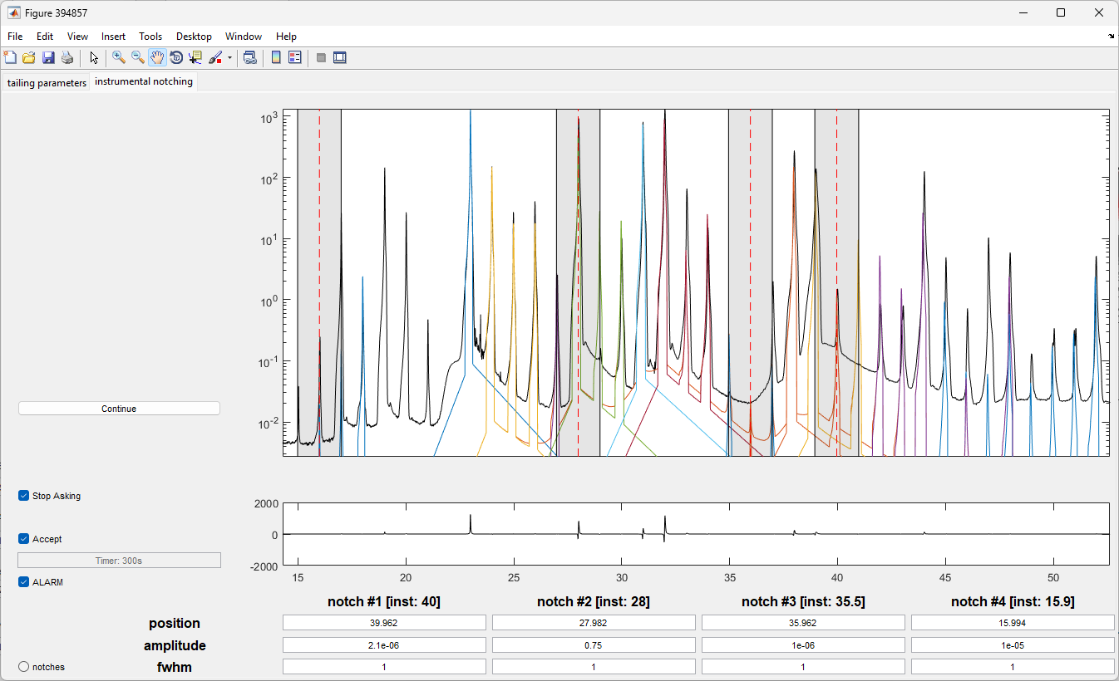
a
b
c
d
g
e
f
g
h
i
m
n
o
a
p
q
r
s
b
t
c
h
d
e
i
*
*
*
*
j
f
k
l

Slide 7
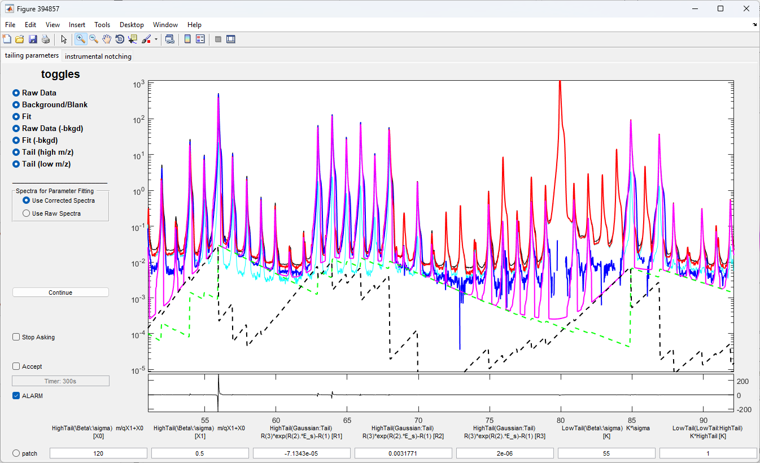
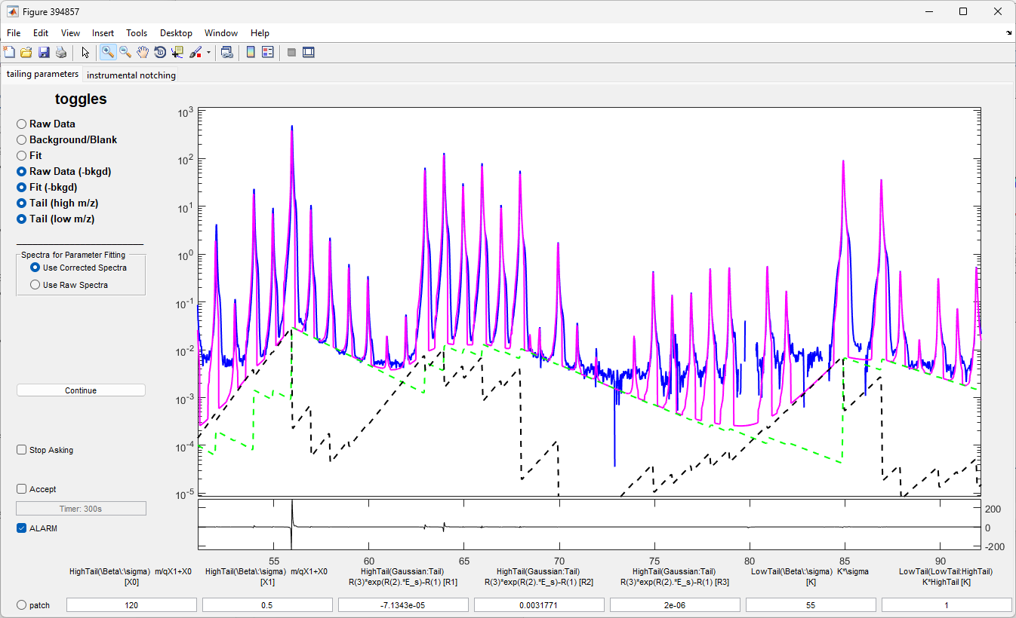
a
b
c
d
i
g
e
j
f
k
g
l
h
m
i
n
j
o
k
w
l
m
n
o
a
p
q
r
s
b
t
c
d
h
e
f
p
q
r
s
t
u
v

Slide 8

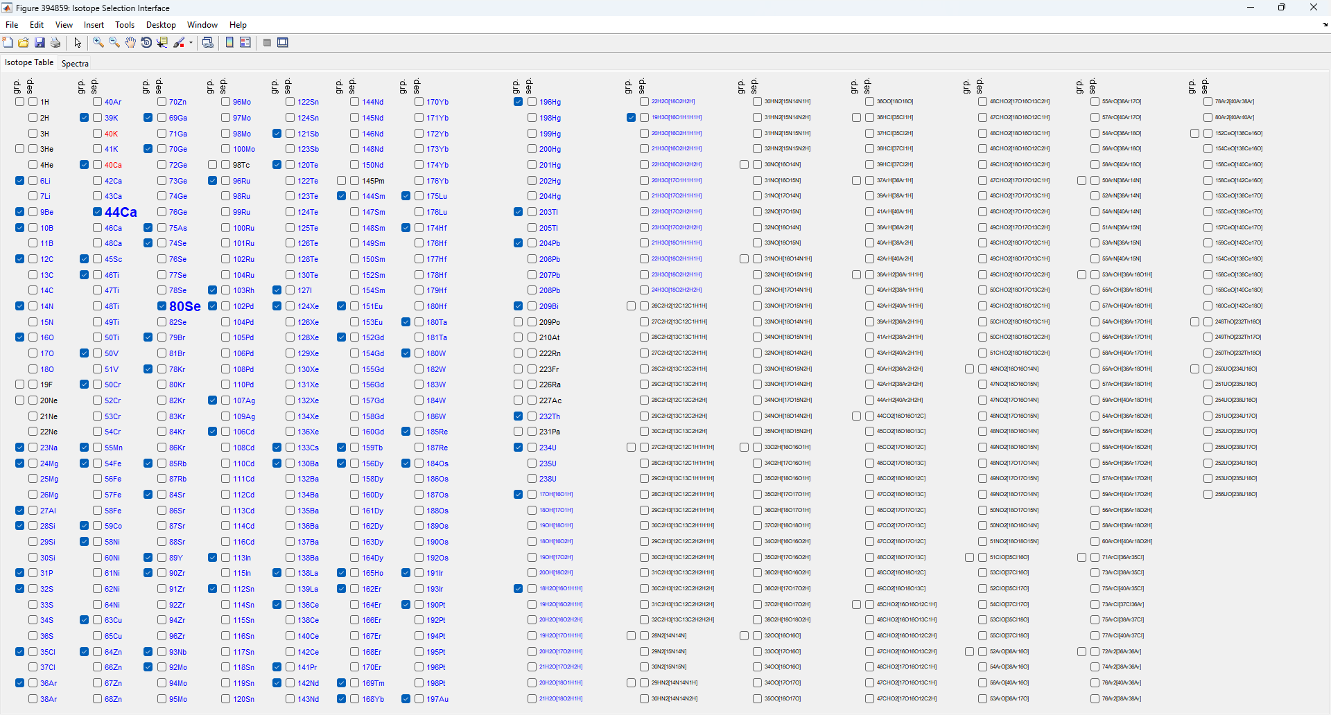
c
a
b
d
e
g
h
f

Slide 9
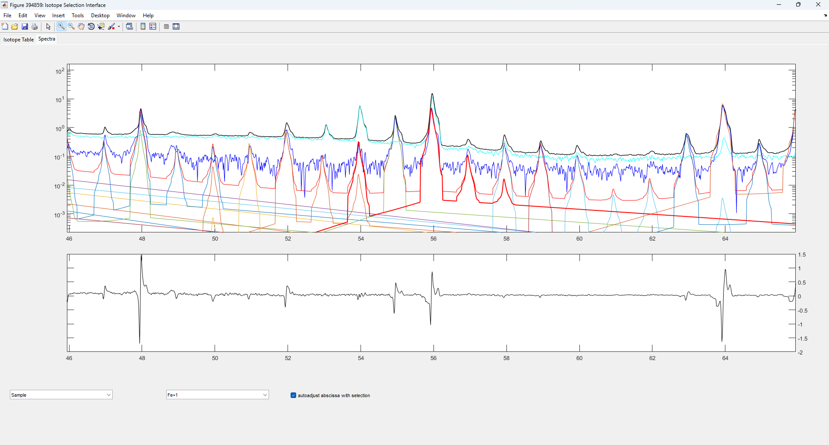

h
raw integrated spectrum
background/baseline/blank
corrected integrated spectrum [raw-bkgd]
selection from f
a
b
fit to corrected integrated spectrum
c
j
k
l
m
d
n
o
p
b
s
q
t
r
s
t
e
f
g

Slide 10
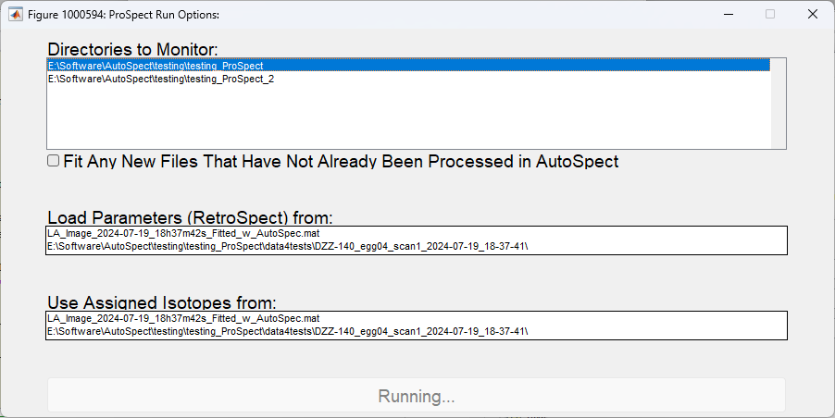



a
[context menu]
g
b
h
n
c
[context menu]
o
d
i
p
q
j
r
k
s
t
e
[context menu]
f
i
l
m
k

